Slide 1
Customer Churn Prediction
NEXAFRICA MACHINE LEARNING INTERNSHIP
Finding the customers who are about to leave, before they do
Gyimah Ramsey Opoku | October 2026
Notes:
Introduce yourself and the project in one sentence: this is a model that predicts which telecom customers are likely to leave, built during the NexAfrica Machine Learning Internship. The talk follows the same path as the project: the business problem, the data, the models, and what the company should do about it.

Slide 2
Losing a customer costs more than it seems
Replacing is expensive
Future revenue is lost
The goal of the model
Winning a new customer takes marketing spend, sales time and onboarding effort.
The company loses everything that customer would have paid over the rest of the relationship.
Give every customer a churn probability, so retention offers go to the people most likely to leave.
Customer Churn Prediction | NexAfrica ML Internship
2
Notes:
Explain churn in plain words: customers who stop doing business with the company. The cost is bigger than the lost monthly bill, because replacing a customer is expensive and the future revenue is gone too. The model does not just say yes or no. It gives each customer a probability, so the company can rank customers and spend its retention budget on the highest risks first.

Slide 3
The data: 7,043 telecom customers
7,043
21
26.5%
customers, one row each
columns: demographics, services, contract and billing
of customers churned, 73.5% stayed
Target: Churn (Yes or No). With this split, a model that always says "stay" would be right 73% of the time and catch no one, so accuracy alone cannot be trusted.
Customer Churn Prediction | NexAfrica ML Internship
3
Notes:
This is the public Telco Customer Churn dataset: 7,043 customers and 21 columns. About one customer in four churned. That imbalance matters later. A lazy model that always predicts that a customer stays would be right about 73 percent of the time while catching no churners at all, so we judge the models on recall, precision, F1 and ROC-AUC rather than accuracy.

Slide 4
Data preparation: one hidden problem
Check | What we found | What we did
Missing values | TotalCharges looked complete, but 11 rows held a blank space. All were new customers with tenure 0. | Converted to numbers and filled with 0
Duplicates | None found | Nothing needed
Data types | TotalCharges was stored as text | Now a numeric column
Categories | No typos or spacing errors | Nothing needed
Why it matters: a standard null check reported zero missing values, so the problem stayed invisible until the column type was questioned.
Customer Churn Prediction | NexAfrica ML Internship
4
Notes:
The data was mostly clean, but one issue could have quietly broken things. TotalCharges was stored as text, and 11 rows held a blank space instead of a number, which a normal missing-value check does not catch. All 11 were brand-new customers with zero tenure, so no total had built up yet. Filling them with 0 is the consistent choice. The other checks, duplicates and category spelling, found nothing.

Slide 5
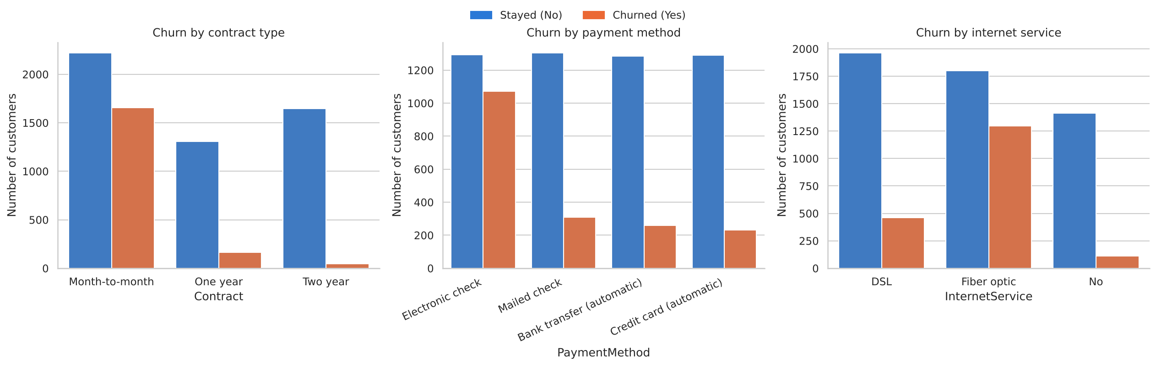
Churn is concentrated in a few groups
42.7%
45.3%
41.9%
churn on month-to-month contracts, versus 2.8% on two-year
churn among electronic check payers
churn on fiber optic; churners' median tenure is 10 months versus 38
Customer Churn Prediction | NexAfrica ML Internship
5
Notes:
Three patterns stand out. Customers on month-to-month contracts churn at 42.7 percent, against 2.8 percent on two-year contracts. Electronic check payers churn at 45.3 percent. Fiber optic customers churn at 41.9 percent. Churners also leave early: their median tenure is 10 months compared with 38 for customers who stay. These are associations in the data, not proof of cause.

Slide 6
Three new features from existing columns
Feature | How it was built | Why it helps
NumServices | Count of add-on services each customer uses | Captures how deeply a customer is tied to the company
TenureGroup | Tenure in months grouped into bands | Lets the model see that risk changes with customer age
HasInternetService | Yes or no flag from the internet service column | Separates phone-only customers from the rest
Categorical columns were one-hot encoded and numeric columns scaled, so every model starts from the same 80/20 stratified split.
Customer Churn Prediction | NexAfrica ML Internship
6
Notes:
Feature engineering means creating new columns that express patterns the raw data hides. NumServices counts how many add-ons a customer has, TenureGroup bands the months of tenure, and HasInternetService flags customers who have internet at all. After that, text categories were one-hot encoded and numbers scaled. The split was 80/20 and stratified, so the churn share is the same in training and test data.

Slide 7
Three models, three stages each
Logistic Regression
Decision Tree
Random Forest
Simple and easy to explain. Each feature gets a weight that shows its push toward leaving or staying.
Asks a chain of yes or no questions. Readable, but it can overfit without limits on depth.
Many trees voting together. Usually stronger and steadier, but harder to explain.
Each was tested three ways: a plain baseline, with class weights to counter the 73/26 imbalance (SMOTE was also tried), and tuned with cross-validated search.
Customer Churn Prediction | NexAfrica ML Internship
7
Notes:
Three model families, chosen to span simple to complex. Logistic regression is the easy-to-explain baseline. The decision tree is readable but can memorise the training data. The random forest combines many trees. Each one went through baseline, imbalance handling with class weights and SMOTE, and tuning with GridSearchCV or RandomizedSearchCV on five-fold stratified cross-validation.

Slide 8
After tuning, the models are close
Model | Accuracy | Precision | Recall | F1 | ROC-AUC
Logistic, baseline | 0.800 | 0.655 | 0.519 | 0.579 | 0.842
Logistic, class-weighted | 0.732 | 0.498 | 0.791 | 0.611 | 0.842
Decision Tree, tuned | 0.742 | 0.509 | 0.810 | 0.625 | 0.838
Random Forest, tuned | 0.753 | 0.523 | 0.781 | 0.627 | 0.842
Accuracy drops when recall rises, and that is the right trade: missing a churner costs more than a wasted offer. With scores this close, the choice rests on stable recall in cross-validation (0.80 for logistic versus 0.76 for the forest) and on how easily the model can be explained.
Customer Churn Prediction | NexAfrica ML Internship
8
Notes:
Baseline logistic regression has the best accuracy at 0.80, but it only catches 52 percent of churners. Adding class weights lifts recall to 79 percent at the cost of accuracy, which is the trade we want because a missed churner is the costlier mistake. After tuning, the three models are within a few points on every metric. Cross-validated recall favours logistic regression, 0.802 against 0.761 for the forest, and it is the easiest to explain to a business team, so it is the final model. The tuned tree matched recall but had the lowest F1, AUC and precision.

Slide 9
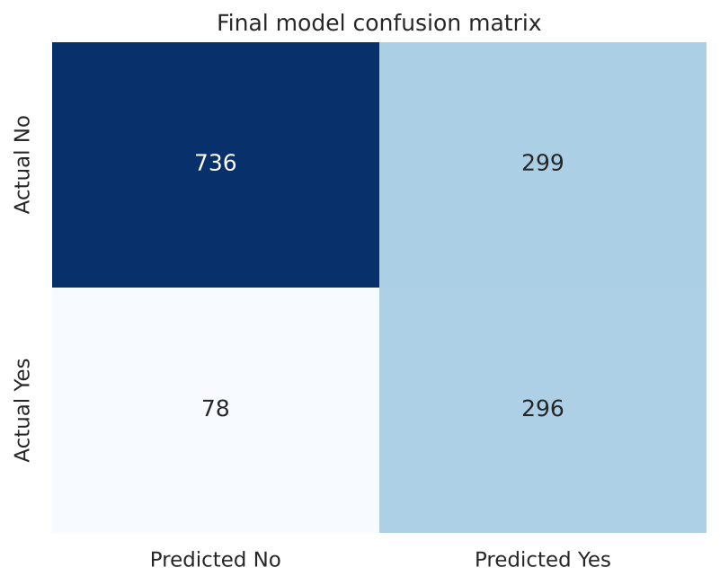
Recall rose from 52% to 79%
FINAL MODEL: CLASS-WEIGHTED LOGISTIC REGRESSION
Of 374 customers who churned in the test set, the model caught 296 and missed 78. It raised 299 false alarms among customers who stayed.
Customer Churn Prediction | NexAfrica ML Internship
9
Notes:
This is the headline result. On the held-out test set there were 374 churners. The model caught 296 of them and missed 78. The price is 299 false alarms, customers flagged who would have stayed. A wasted retention offer is cheap compared with a lost customer, so this is the trade the business should want. Be honest about precision: about half of the flagged customers are real churners.

Slide 10
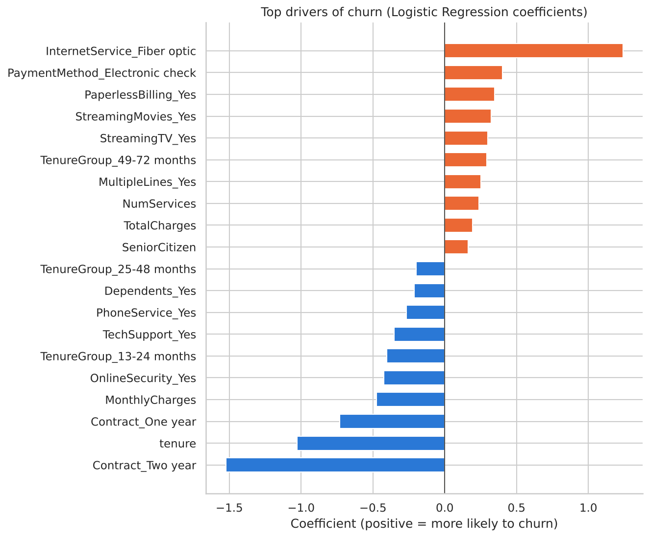
What the model pays attention to
Contract length and fiber optic internet carry the largest weights toward churn.
Longer tenure and two-year contracts push strongly toward staying.
Tenure, total charges and monthly charges overlap, so their individual weights should be read with care.
These are associations, not proof of cause.
Customer Churn Prediction | NexAfrica ML Internship
10
Notes:
The chart shows the logistic regression coefficients. Bars to the right raise churn risk and bars to the left lower it. Contract type and fiber optic service stand out, and long tenure protects against churn. A caution: tenure, tenure group, total charges and monthly charges move together, so the model splits credit among them. Treat the ranking as a guide to where to look, not as a measure of cause.

Slide 11
Six actions for the retention team
Move customers to longer contracts
Encourage automatic payment
Churn is 42.7% month-to-month and 2.8% on two-year plans.
Electronic check payers churn at 45.3%.
Review fiber optic quality and price
Invest in the first year
41.9% of fiber customers leave.
Churners' median tenure is 10 months, so onboarding matters.
Bundle support and security
Spend by churn probability
Customers with these add-ons churn about 15%, versus 42% without.
Rank customers with the model and offer to the highest risks first.
Customer Churn Prediction | NexAfrica ML Internship
11
Notes:
Each action ties back to a pattern in the data. Longer contracts, automatic payment and fiber optic quality address the three biggest churn groups. Early onboarding targets the first year, when churners leave. Bundling tech support and online security lines up with a drop from about 42 percent churn to about 15 percent, though that is an association and should be piloted before a full rollout. Finally, use the model's probabilities to decide who gets an offer. Senior citizens, at 41.7 percent churn versus 23.6, are an optional segment to examine.

Slide 12
Limits and next steps
Limits to keep in mind
Next steps
Precision is about 50%, so half of the flagged customers would have stayed. Findings show association, not cause. Scaling was applied before the split, which can leak a little information.
Tune the decision threshold to the cost of an offer. Try gradient boosting such as XGBoost. Pilot the retention actions on a small group and measure the result.
Thank you. Questions?
Customer Churn Prediction | NexAfrica ML Internship
12
Notes:
Close honestly. The model is a useful ranking tool, not a crystal ball: about half of its flags are false alarms, and the patterns are associations. One technical limitation is that scaling was fitted before the split. Next steps are to tune the decision threshold against real offer costs, try a boosted model, and run a small pilot of the retention actions. Then invite questions.

